Slide 1
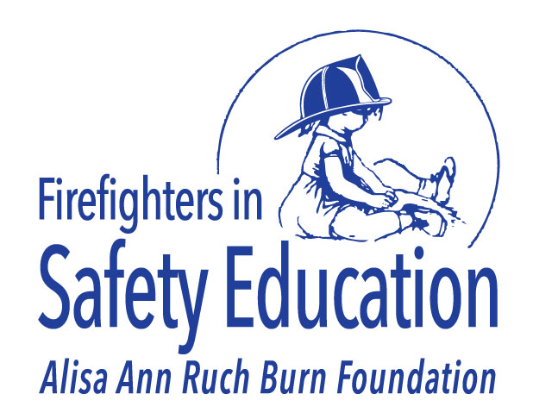
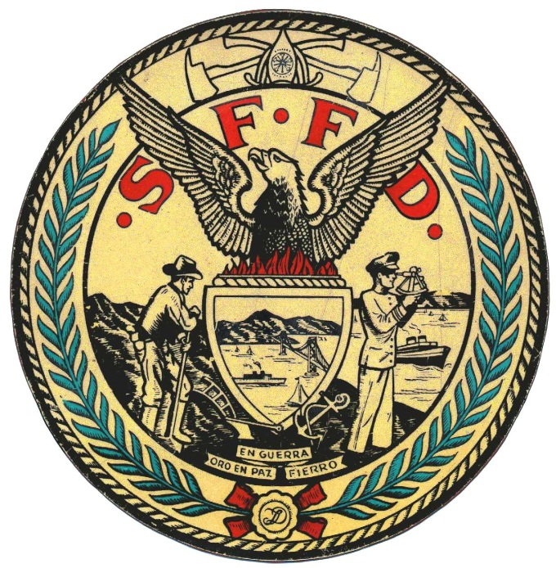
Firefighters in Safety Education
July 9th, 2015
Fire Commission Meeting
Notes:
Welcome and introductions

Slide 2
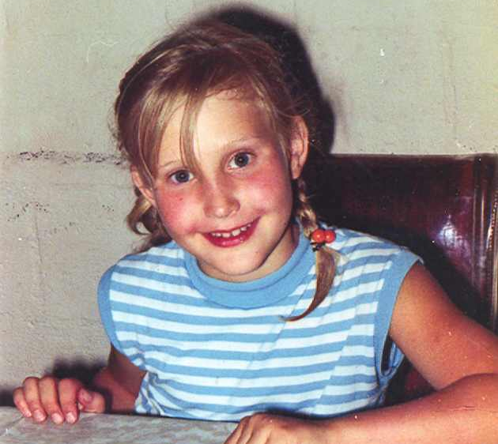
Organizational History
At age eight, Alisa Ann Ruch was fatally injured in a backyard barbecue accident in Southern California.
Bravely using their tragedy as a catalyst for change, Alisa Ann’s parents, local firefighters and medical professionals joined together and created the Alisa Ann Ruch Burn Foundation (AARBF),
a 501(C)3 nonprofit organization, in 1971.
Notes:
AARBF History

Slide 3
Mission and Vision
MISSION
The Alisa Ann Ruch Burn Foundation’s
mission is to enhance the quality of life
for burn survivors and promote burn
prevention education.
VISION
It is the Alisa Ann Ruch Burn Foundation
vision to positively impact the lives of every
burn survivor in California and make burn
injuries a thing of the past.

Slide 4
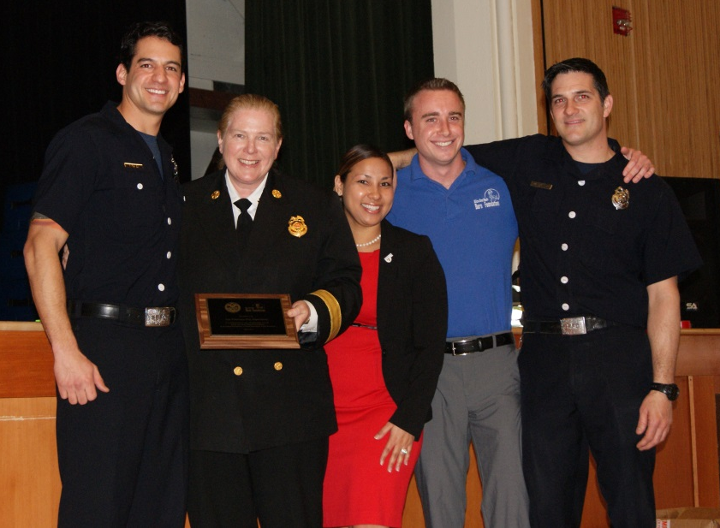
Firefighters in Safety Education
Firefighters in Safety Education (FISE) provides free burn prevention education and materials to thousands of elementary school children every year. Our goal is to bring burn prevention to “each child, each year” in schools and in the students’ native languages.
2015 marks the 15th Anniversary of AARBF’s partnership with SFFD through the FISE Program!

Slide 5
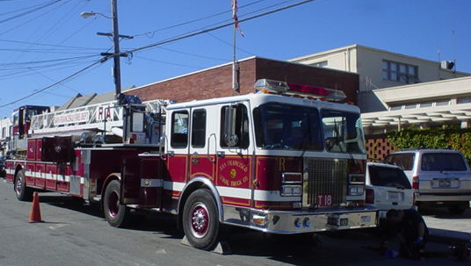
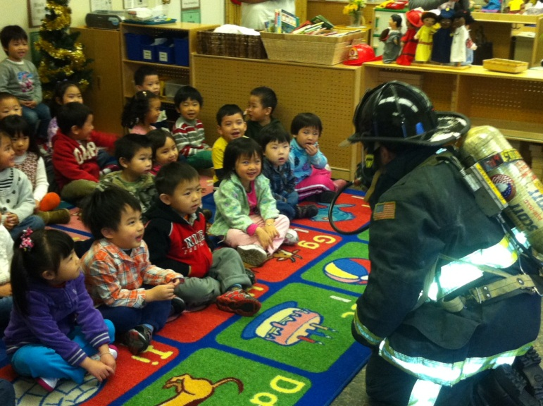
How it works:
Notes:
Contact to schools
Setup presentation (times, location, number of students, coloring books)
Evaluations, parent letters, ect
Day of:
10 minutes before presentation: You arrive to school office and introduce yourself
8:30 to 12PM: Give presentation, maybe 2, always 10 minutes between
Engine detail, might follow
5

Slide 6
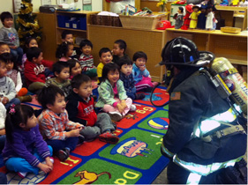
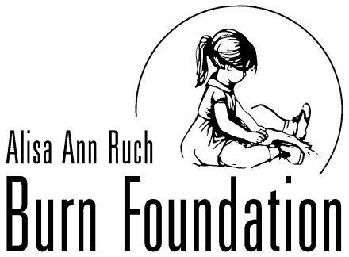
Firefighters in Safety Education
Smoke Alarms
Crawl Low & Go
Stop Drop & Roll
Cool a Burn
Toys vs Tools
How to Dial 9-1-1
Hug a Firefighter

Slide 7
Pre- and Post-Testing

Slide 8
San Francisco Evaluation
Notes:
Why FISE? Because it works! Evaluation
N=1,283, 13 schools in 2010
Kindergarten (n=231), learning 15.6%
First, Second and Third (n=623), learning 15%
Fourth and Fifth (n=339), learning 23%
Binary quantitative data (Graphs)
qualitative data (quotes)
8

Slide 9
Each child, Each year
Alisa Ann Ruch Burn Foundation
Notes:
This is why its important to present the same information each time,
Data Collected, qualitative and quantitative
Post Tests Comparing Schools
-Graphs
9

Slide 10
San Francisco Fire Fatalities
Alisa Ann Ruch Burn Foundation
Notes:
This is why its important to present the same information each time,
Data Collected, qualitative and quantitative
Post Tests Comparing Schools
-Graphs
10

Slide 11
San Francisco
Firefighters in
Safety Education
Notes:
This program is the ONLY fire and burn prevention education program that has been sanctioned by Chief Joanne Hayes-White to be taught to SF School children.
SFFISE is in its 15th year of partnership between AARBF and SFFD to serve the SFUSD
Mission: To save lives and property through prevention and education.
Goal: to make each child an ambassador of safety to their families
Materials are available in Spanish, Cantonese additional materials in Russian, Tagalog and Vietnamese
To reach each child, each year.
Success: Educated Over 100,000 students in San Francisco since 2001 with an average of 9,000 students in 60 different presentations each year
11

Slide 12
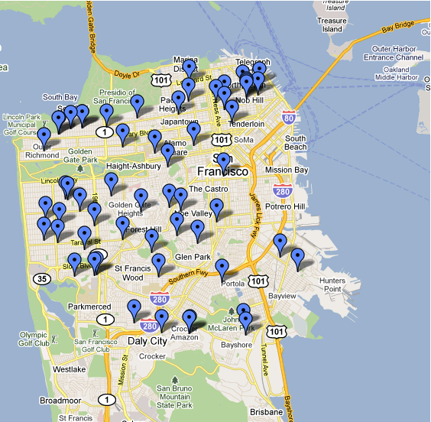
Serving San Francisco
2001-2015
- Over 101,600 Students
- 65 Public, Private & Parochial - 37 Local 798 Volunteers
- 4 languages
- Serving every neighborhood
Notes:
Accomplishments: Numbers
Mission: To save lives and property through prevention and education.
Goals: to make each child an ambassador of safety to their families
Materials are available in Spanish, Cantonese additional materials in Russian, Tagalog and Vietnamese
Success: Educated Over 100,000 students in San Francisco since 2001 with an average of 9,000 students in 60 different presentations each year
12

Slide 13
San Francisco
2014-2015
- 12,642 Students
- 56 Public, Private & Parochial – 14 active Volunteers
- 3 languages
Serving every neighborhood in San Francisco
Notes:
Accomplishments: Numbers
Mission: To save lives and property through prevention and education.
Goals: to make each child an ambassador of safety to their families
Materials are available in Spanish, Cantonese additional materials in Russian, Tagalog and Vietnamese
Success: Educated Over 100,000 students in San Francisco since 2001 with an average of 9,000 students in 60 different presentations each year
13

Slide 14
Successes in 2014-2015
2015 marked the our 15th year anniversary between the San Francisco Fire Department and the Alisa Ann Ruch Burn Foundation
Reached a record high of 12,642 students; almost 30% increase from our annual average
We trained 9 new San Francisco Fire Fighters as volunteers
Was published in the American Burn Association Journal for the second time.
Expanded F.I.S.E. outside of San Francisco to 7 new cities throughout California.

Slide 15
Thank you!
Notes:
15

