Slide 1
Services of the San Francisco Public Utilities Commission
Presentation to
San Francisco Fire Commission
Auxiliary Water Supply System:
Operational Reliability
and ESER Bond Improvements
June 25, 2015 Katie Miller, CDD Division Manager
David Briggs, Regional and Local Water Systems Manager
San Francisco Public Utilities Commission

Slide 2
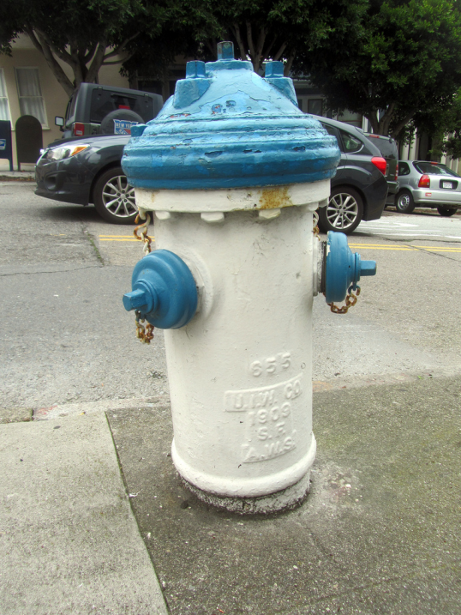
Auxiliary Water Supply System (AWSS) Overview
AWSS System Overview
2010 & 2014 ESER Bond Improvements
SFPUC Operations and Maintenance
SFFD/SFPUC MOU Highlights

Slide 3
SFFD and SFPUC are “closely related and mutually involved in fire protection.”
- Keith P. Calden, SFFD Chief 1971

Slide 4
AWSS History
AWSS: High-pressure seismically reliable water distribution system for fire-fighting.
Built 1910-1914 following Great Earthquake and Fires.
Operated and maintained by SFFD with support from SFDPW
Separate system from low-pressure potable water system that is operated and maintained by SFPUC.
Not to be confused with Portable Water Supply System (PWSS): owned and maintained by SFFD.
2010: AWSS assets transferred from SFFD to SFPUC
2010 + 2014: ESER Bond-funded improvements
2015: MOU between SFFD and SFPUC

Slide 5
AWSS System Map
AWSS Facilities:
135 miles pipes
1 reservoir
2 tanks
2 salt-water pump stations
154 cisterns
1,575 hydrants
pressures up to 328 psi

Slide 6
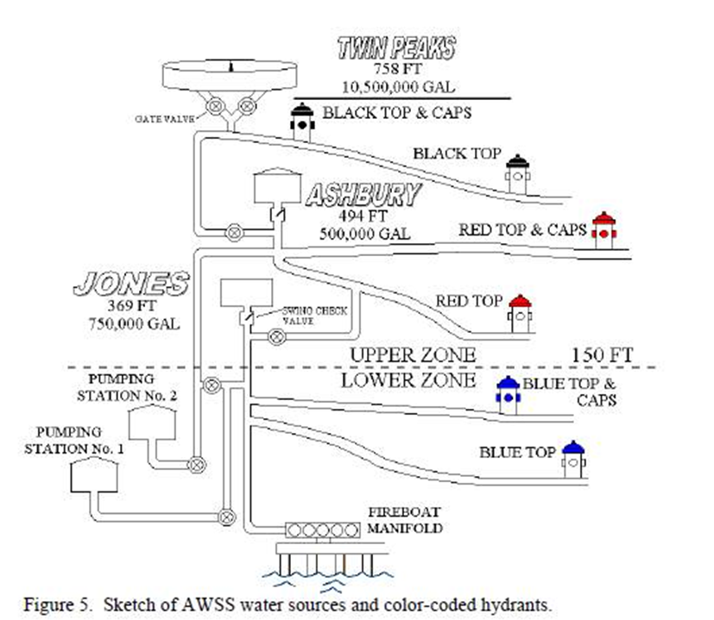
AWSS Schematic

Slide 7
Twin Peaks Reservoir: Dedication 1914

Slide 8
ESER Bond 2010 Improvements
ESER Bond 2010: $108M for reliability improvements to facilities, pipelines and cisterns
$2M Planning Evaluation
Improvements at Ashbury and Jones Street Tanks, Pump Station Nos. 1 and 2; Twin Peaks Reservoir
30 new cisterns by 2017
Pipeline condition assessment and repairs:
Leak detection 70 miles pipe
Pipeline R&R recommendations in 2017

Slide 9
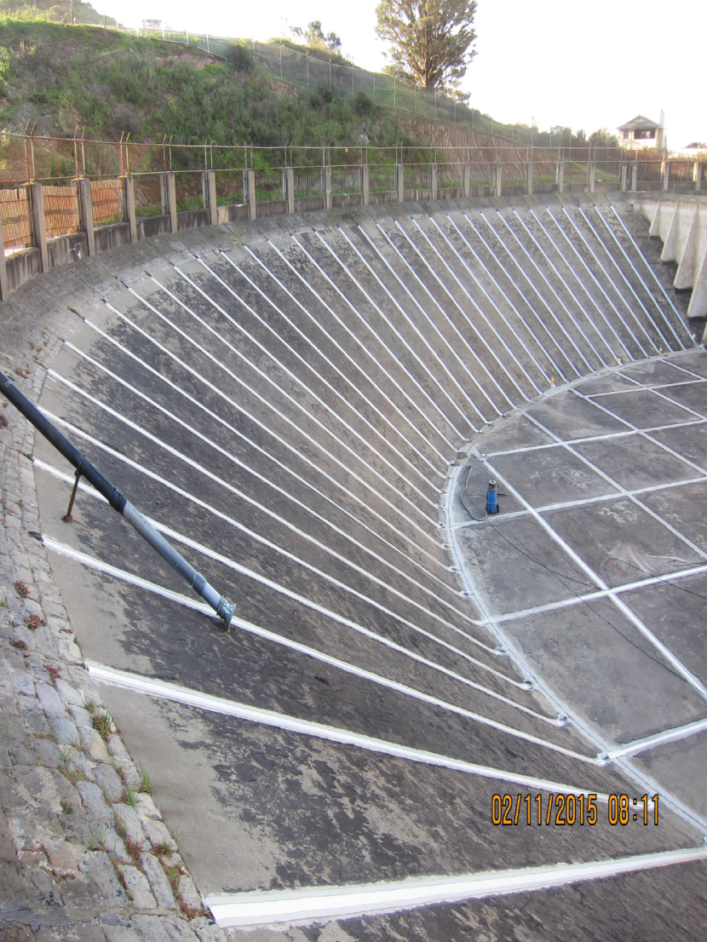
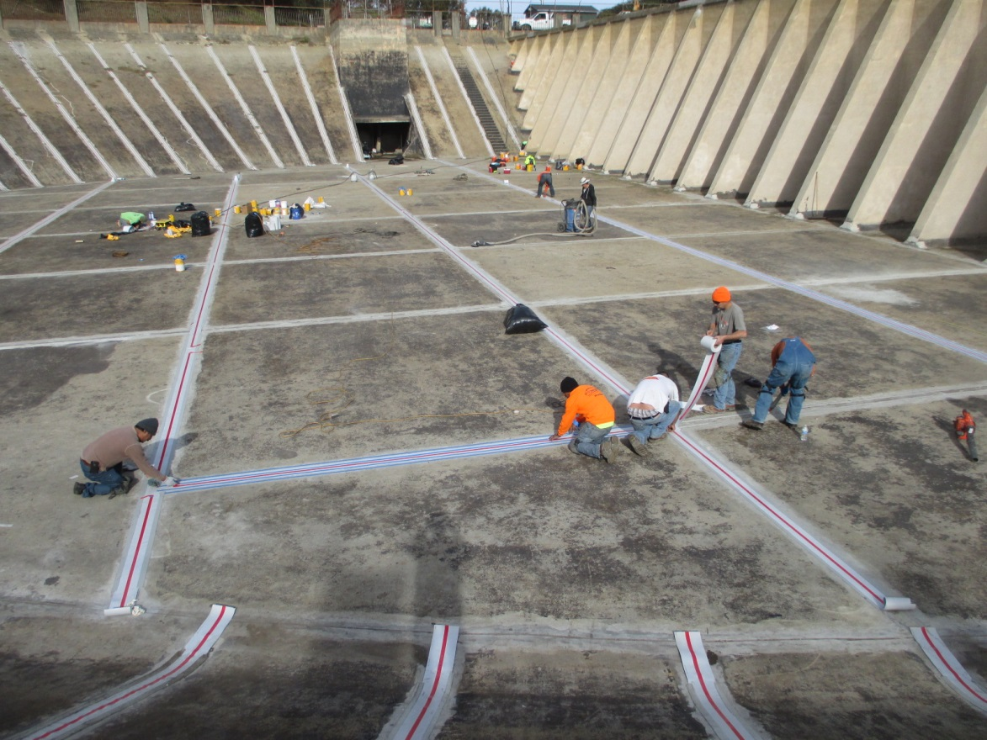
Twin Peaks Reservoir Joint Sealing: Saves 150,000 gallons water per day!

Slide 10
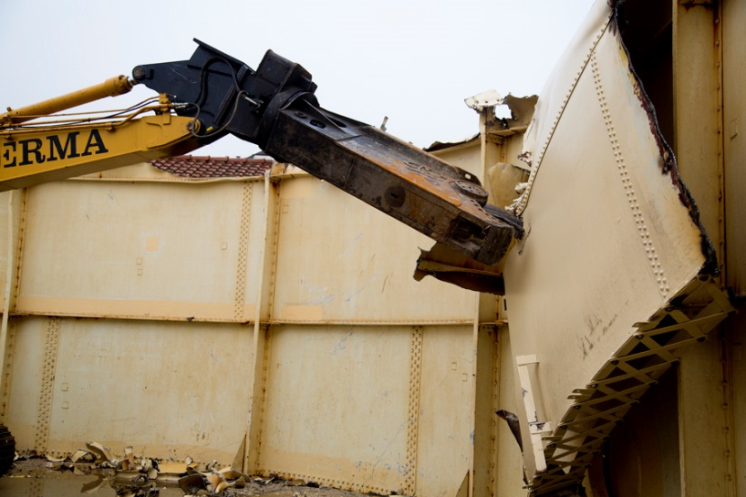
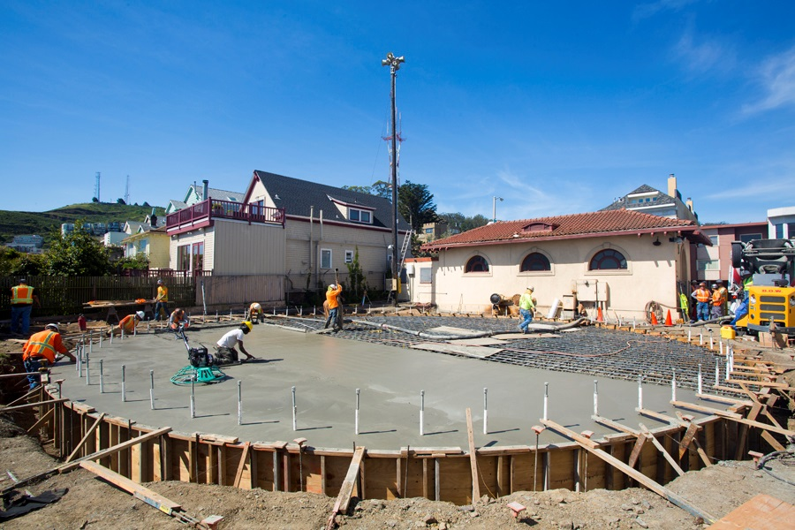
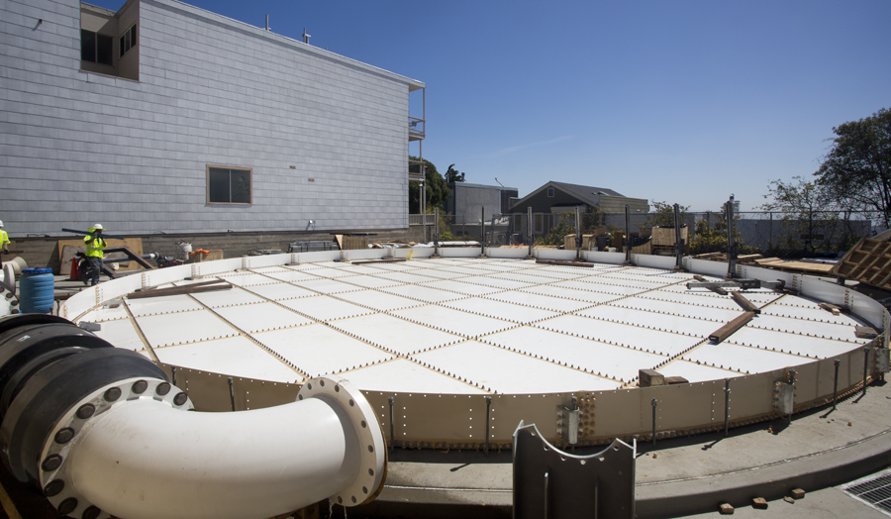
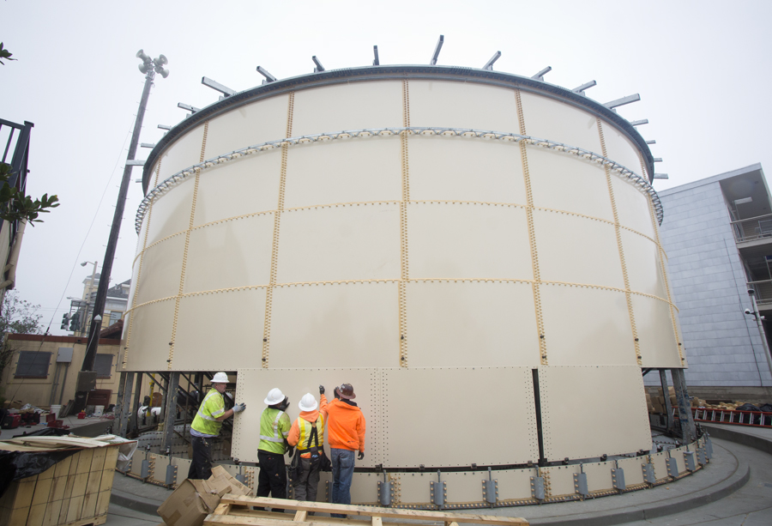
Ashbury Heights Tank New Tank Complete 2014-15

Slide 11
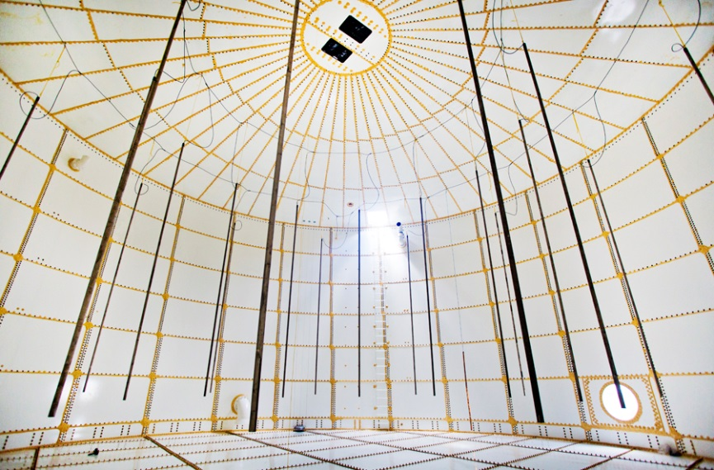
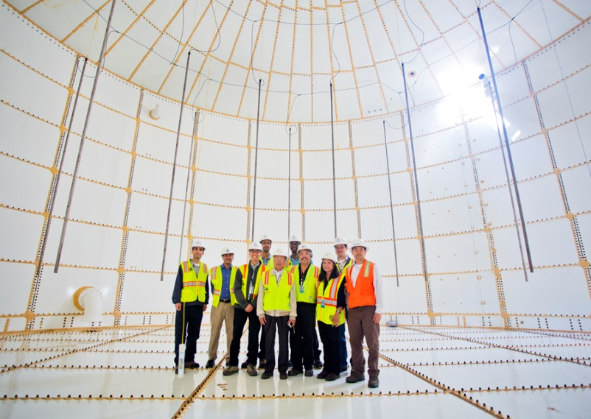
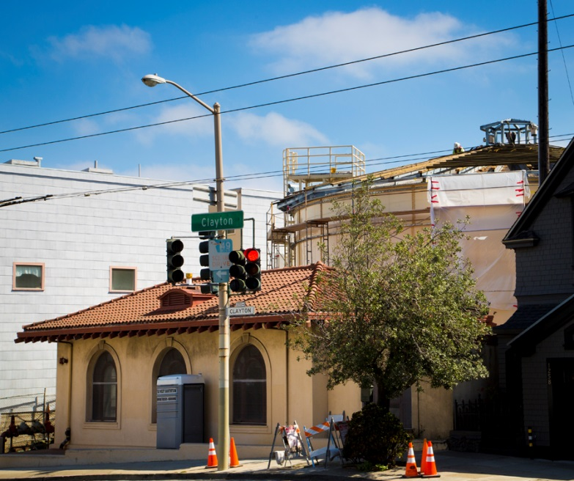
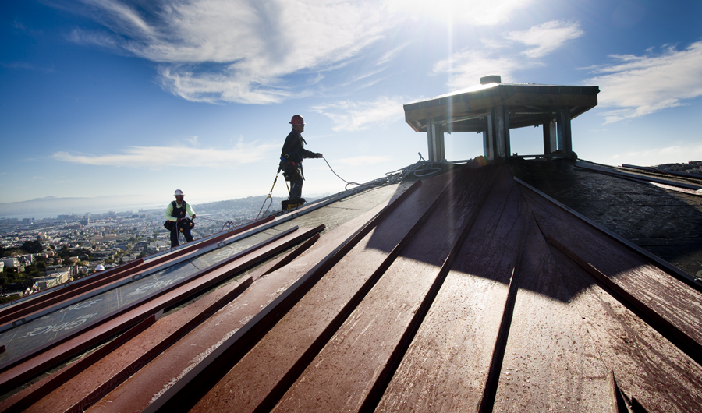
Ashbury Heights Tank

Slide 12
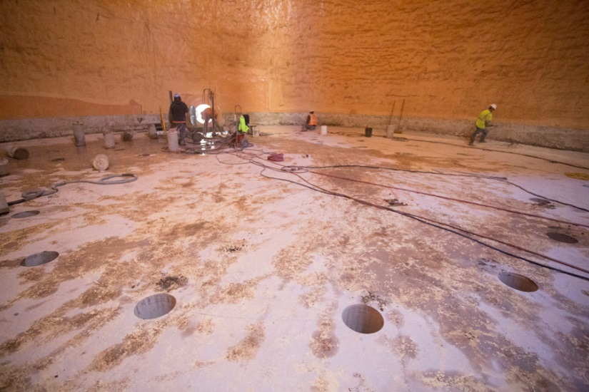
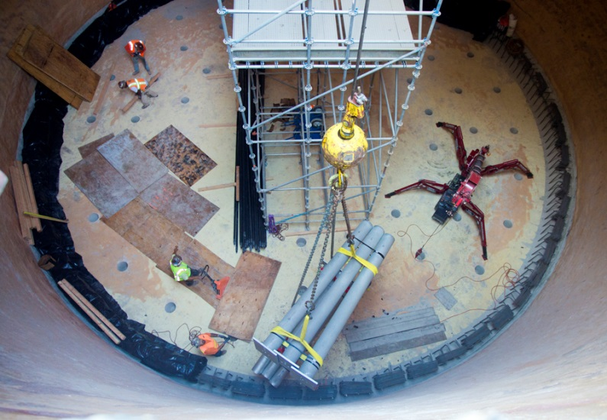
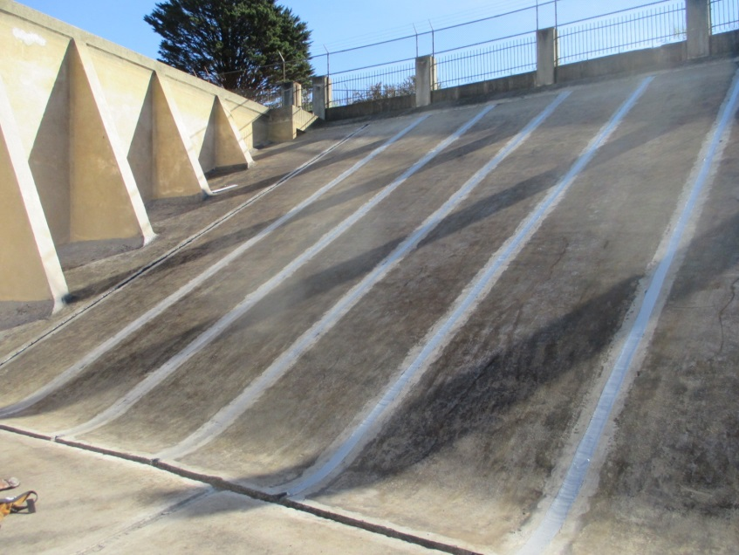
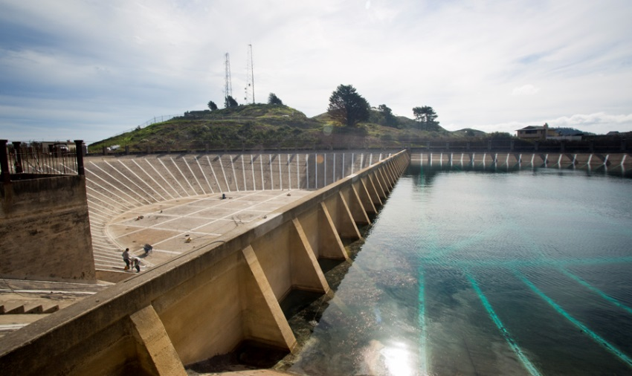
Jones Street Tank Foundation Micropiles & Twin Peaks Reservoir Joint Sealing (2015)

Slide 13
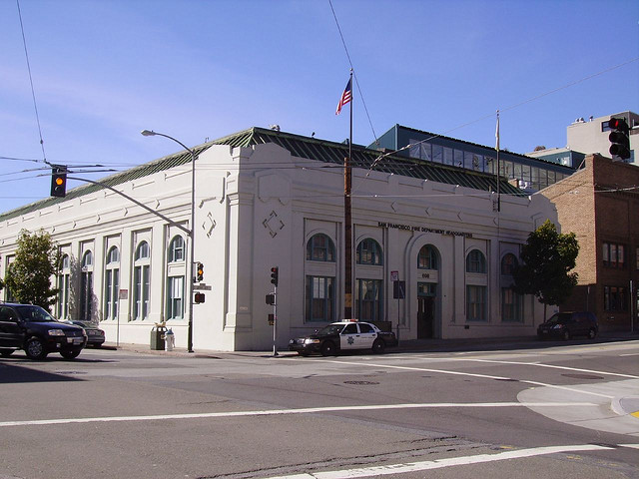
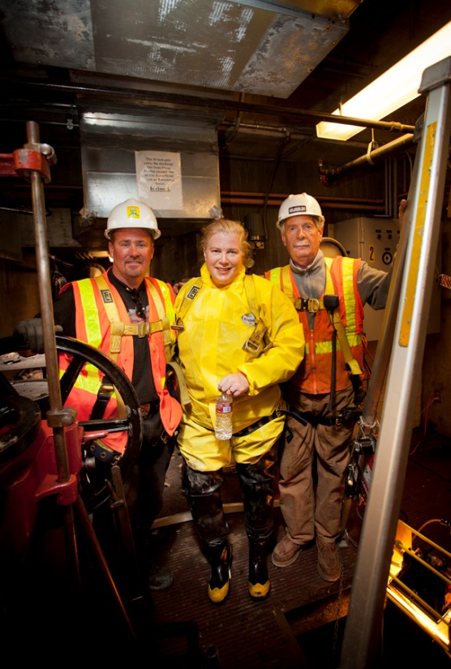
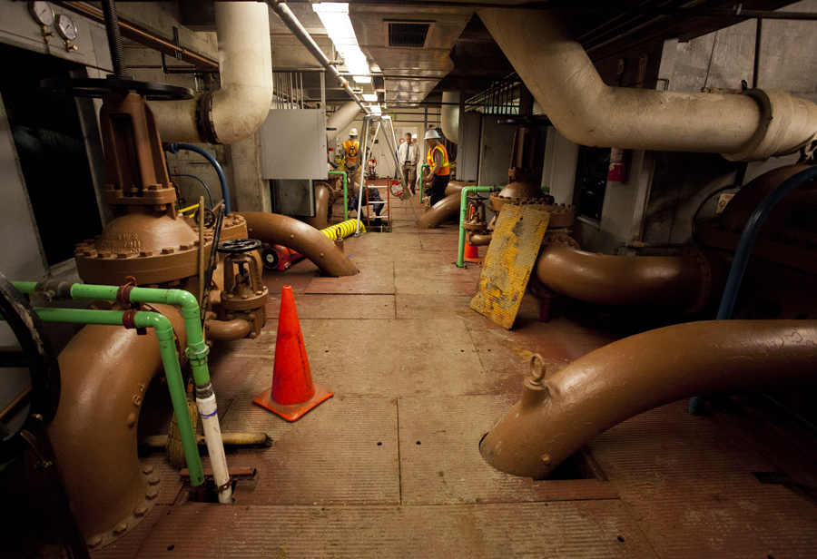
Saltwater Pump Stations
Pump Station 1 (SFFD Headquarters)
Four new 760-hp diesel engines
New electric generator
New exhaust and ventilation
Pumps out of service June 2015–Feb 2016
Project completion May 2016
Pump Station 2 (Ft. Mason) Renovation – 2016 to 2018

Slide 14
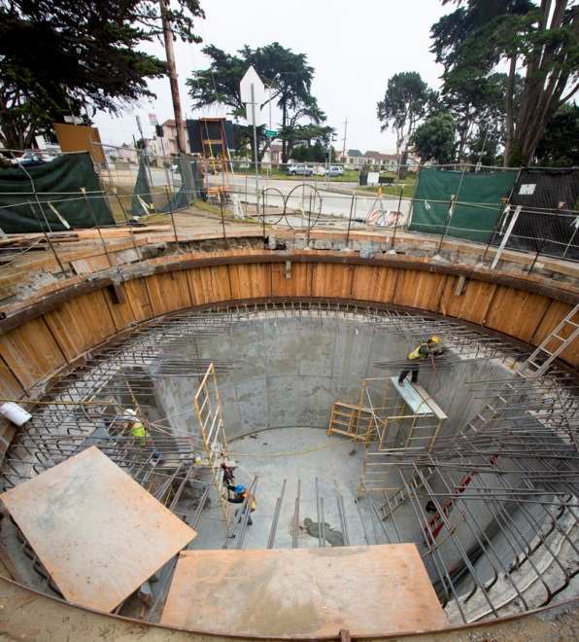
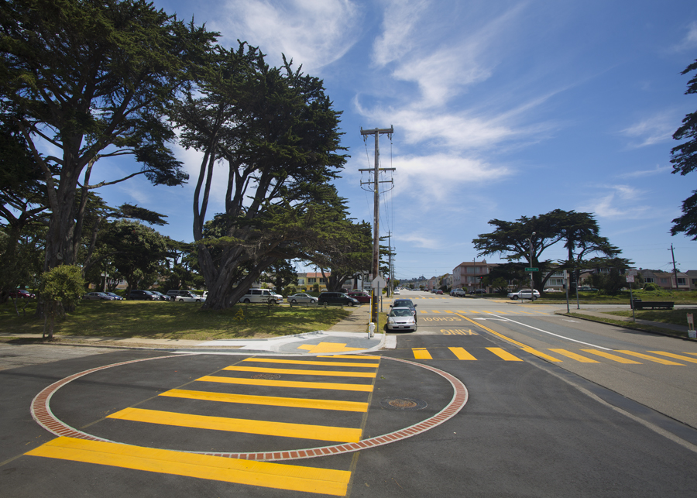
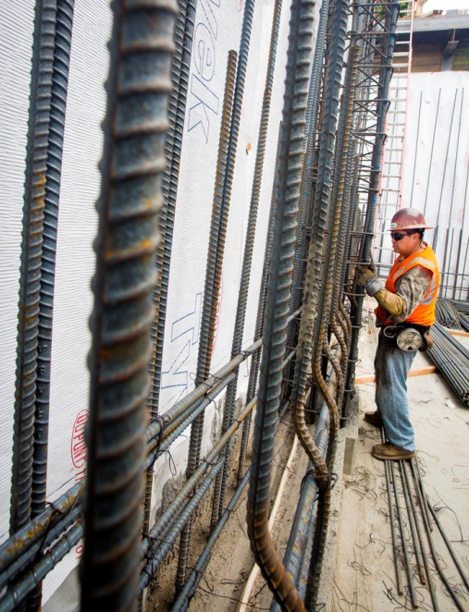
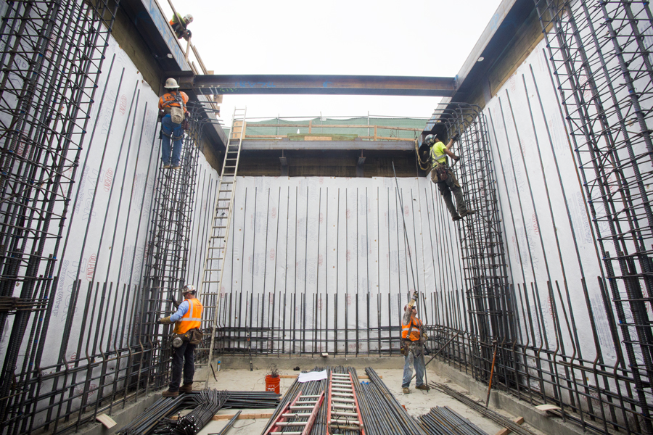
30 New Cisterns by 2016
37th Avenue & Ortega Street
Funston Avenue & Geary Boulevard

Slide 15
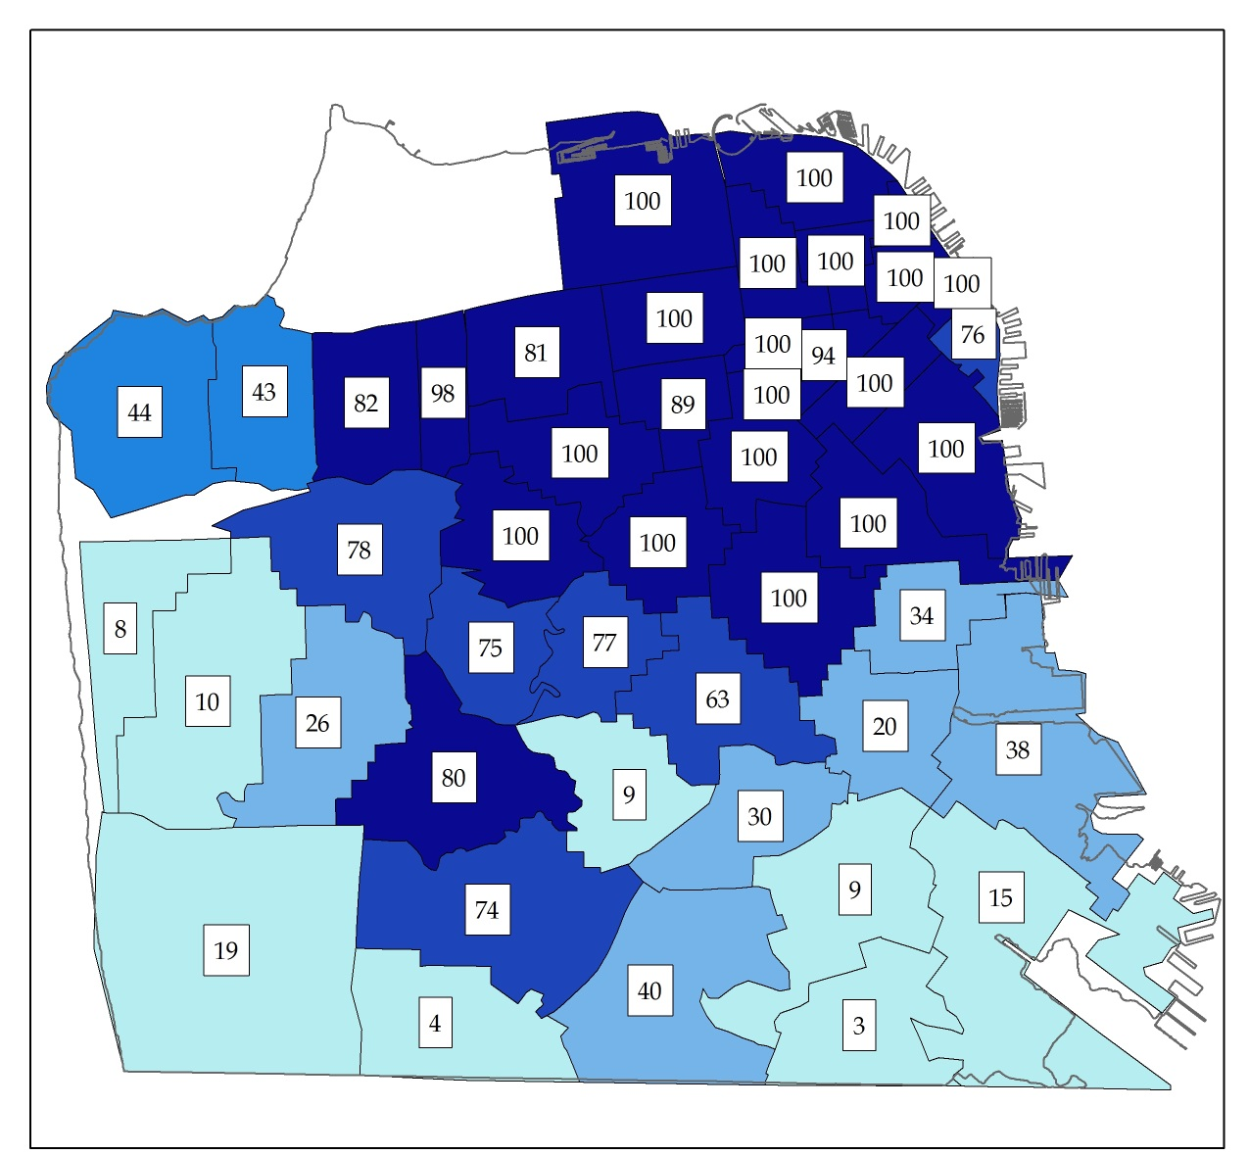
Reliability – at ESER 2010 Completion
Citywide Reliability 68%
Goal: Raise reliability to at least 50% each FRA, 90% Citywide

Slide 16
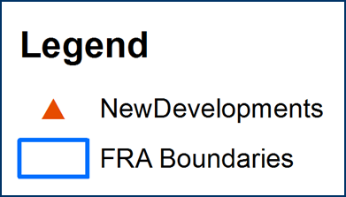
ESER Bond 2014 Projects - $55M
Goal: raise reliability in lower scoring FRA’s
Coordinated with Re-Development Projects for maximum benefit
Combination of Pumping and Storage Facilities, Pipelines, Flexible Systems

Slide 17
SFPUC AWSS Maintenance
Pump Stations
Engines, pumps, generators tested monthly
Significant engine and pump repairs performed since 2010
Bay sediment removed from PS1 and PS2 inlet tunnels
Hydrants
AWSS (1,575) and LP (10,000) hydrants consistently maintained
Hydrant repairs within 1-4 days, when possible
Pipelines
5-10 minor to major repairs to AWSS pipelines annually
Leak reduction: Repairs reduced AWSS pipeline leakage by 700,000 gallons per day in 2014-15!
Engineering drawings and design protocol being updated to maintain rigorous design standards

Slide 18
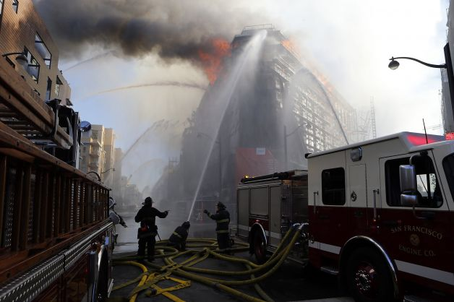
SFPUC Operations
CDD Staff levels:
8 AWSS-dedicated plumbers; >80 plumbers total available for R&R, operations, maintenance
14 “Gatemen” and 17 Stationary Engineers 24/7 for operations and emergency response
Support from electric shop, machine shop, carpenters, laborers, operators, inspectors, full construction fleet
Pipeline engineers for AWSS planning, design, construction, records management, hydraulic analysis
Excellent fire response coordination and support.
Strong SFFD/SFPUC communication protocols.

Slide 19
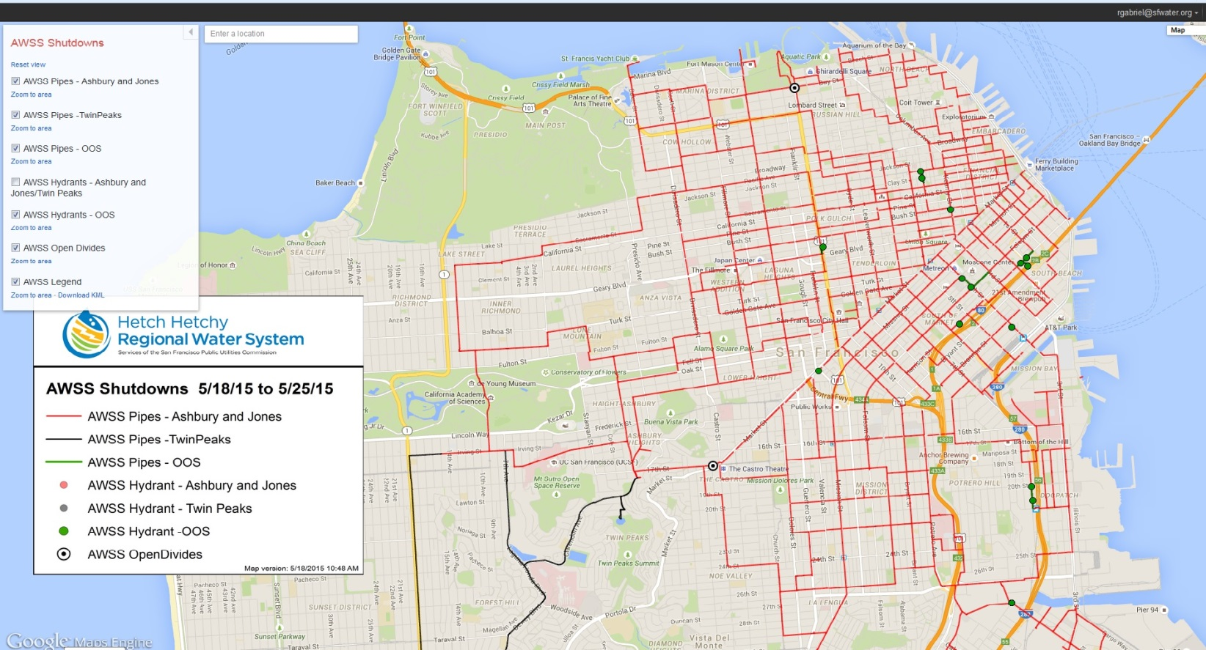
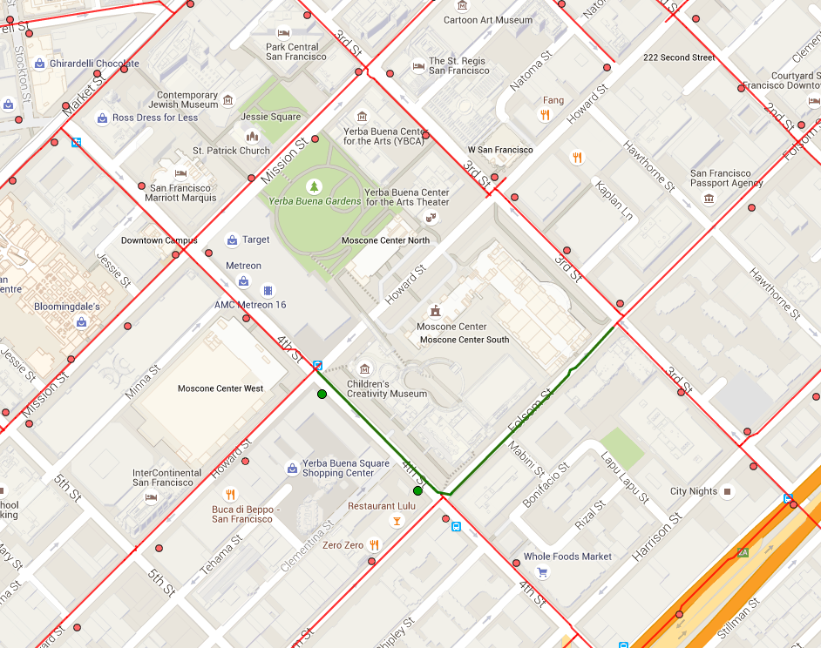
AWSS Shutdowns: Google Maps Engine
Pipes and valves shut down
Hydrants out of service (e.g. “black disked”)
Special operations (e.g. Ashbury to Jones, open divide gates)

Slide 20
Long-term AWSS Funding Strategy
ESER 2010 ($108) and ESER 2014 ($55M) will produce significant performance improvements
Additional GO bond issuances will be needed to meet AWSS coverage goals, and perform R&R.
Additional bond measures and/or leveraging capital investments from other funding sources will be needed:
Developer contributions
Contributions from potable/low-pressure system
Additional GO bond issuances (possibly 2021)

Slide 21
SFFD-SFPUC MOU Highlights
Memorializes Asset Transfer
Outlines Coordination between SFFD and SFPUC:
Emergency Operations
Maintenance Responsibilities
Engineering and Performance Standards
Inspection, Training, and Reporting Responsibilities
Partial funding of dedicated SFFD position to monitor and protect SFFD interests in AWSS

Slide 22
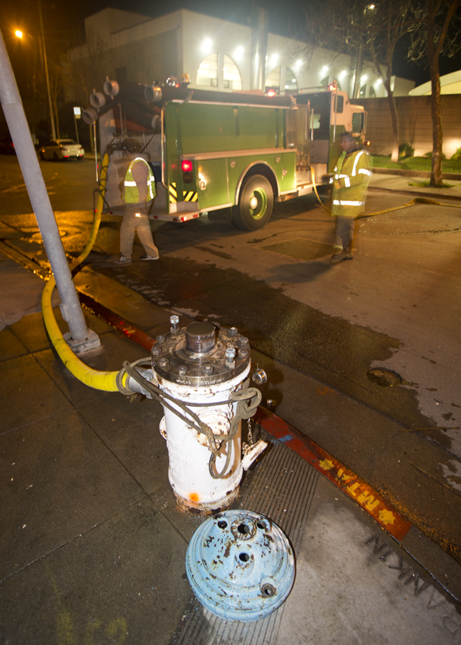
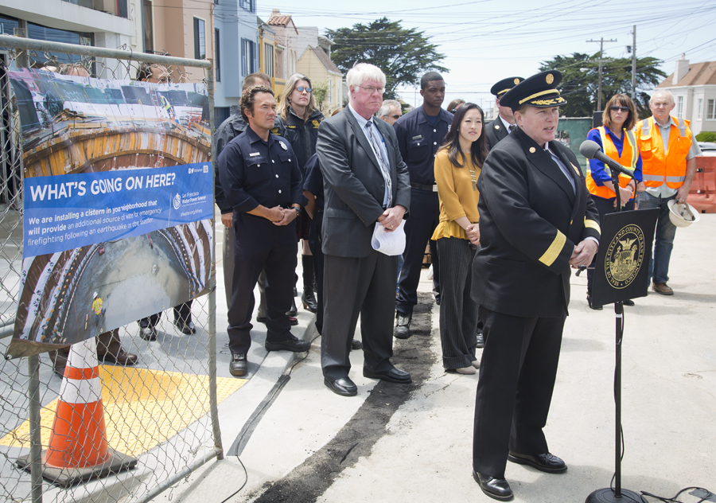
Questions?

Slide 23
Extra Slides

Slide 24
Physical Plant (Core Facilities)
Ashbury Tank
New 500,000-gallon tank
All work completed
Jones Street Tank
Tank foundation and structure reinforcement
Completion November 2015
Twin Peaks Reservoir
New piping and valves
Joint sealing for water conservation
Completion November 2015

Slide 25
New Cisterns
Contract | # | Location | Constructing | Completed | Contract Completion
Cisterns A (WD-2695) | 1 | 35th Ave., Irving St. |  |  | Completed
 | 2 | 36th Ave., Wawona St.. |  | 
 | 3 | 37th Ave., Lawton St. |  | 
 | 4 | 37th Ave., Ortega St. |  | 
 | 5 | 37th Ave., Rivera St. |  | 
 | 6 | 37th Ave., Ulloa St. |  | 
Cisterns B (WD-2696) | 1 | Cashmere St., Hudson Ave. |  |  | August 2015
 | 2 | Colby St., Silver Ave. |  | 
 | 3 | Geneva Ave., Moscow St. |  | 
 | 4 | Geneva Ave., Paris St. |  | 
 | 5 | Holyoke St., Silliman St. |  | 
Cisterns C (WD-2697) | 1 | 18th Ave., Ulloa St. |  |  | September 2015
 | 2 | 21st Ave., Ocean Ave. |  | 
 | 3 | Funston Ave., Geary Blvd. |  | 
 | 4 | St. Elmo Way, Yerba Buena Ave. |  | 
 | 5 | St. Francis Blvd., San Buenaventura Way | 

Slide 26
New Cisterns
Contract | # | Location | Bid Pending | Contract Pending | Constructing | Completed | Contract Completion
Cisterns D (WD-2745) | 1 | Amber Dr., Duncan St. |  |  |  |  | May 2016
 | 2 | Casitas Ave., Lansdale Ave. |  |  | 
 | 3 | Diamond Heights Blvd., Duncan St. |  |  | 
 | 4 | Dorchester Way, Ulloa St. |  |  | 
 | 5 | Folsom St., Ripley St. |  |  | 
Cisterns E (WD-2746) | 1 | 16th Ave., Vicente St. |  |  |  |  | November 2016
 | 2 | 17th Ave., Pacheco St. |  | 
 | 3 | 18th Ave., Moraga St. |  | 
 | 4 | 18th Ave., Santiago St. |  | 
 | 5 | Laguna Honda Hospital |  | 
Cisterns F (WD-2747) | 1 | 5th Ave., Cabrillo St. |  |  |  |  | March 2017
 | 2 | 6th Ave., California St. | 
 | 3 | 30th Ave., Lake St. | 
 | 4 | Apollo St., Williams Ave. | 

Slide 27
Pipelines & Tunnels
Jones Street Tank Valve Motorization – Motorize inter-zone control valves. Construction completion November 2015.
Pipeline Investigation and Remediation – Assess condition of AWSS pipeline network and recommend long-term repair, replacement, and abandonment plan. Recommendations due 2017.
Pumping Station 1 Tunnel – Improve Pumping Station 1 seawater tunnel to accommodate seismic movement. Implementation strategies are being developed.
Street Valve Motorization – Motorize pipeline valves near 20th/Harrison, Clarendon/Twin Peaks, Evans/Napoleon, and Kearny/Sacramento intersections for better water control. Design completion October 2015.

Slide 28
ESER 2014 Projects
19th Avenue Pipeline Replacement – Install new 20” pipeline on 19th Avenue from Irving Street to Kirkham Street in combination with sewer, water, paving, and transit capital improvement project. Design completion June 2016.
Candlestick Point Pipeline Installation – Carroll Avenue – Install new 20” pipeline on Carroll Avenue from Hawes Street to Ingalls Street in support of Candlestick Point development project. This work will be constructed as part of Public Works’ Potrero Streetscape project, scheduled to start August 2015.
Irving Street Pipeline Replacement – Install new 20” pipeline on Irving Street from 7th Avenue to 19th Avenue in combination with sewer, water, paving, and transit capital improvement project. Bid advertisement December 2015.

